Slide 1


Next Up:
Justin Grote

Slide 2
3
3

Slide 3
2

Slide 4

1
JustinGrote

Slide 5

Optimizing Visual Studio Code for PowerShell, 2024 Edition
Justin Grote
Session Content

Slide 6

Many thanks to our sponsors:

Slide 7
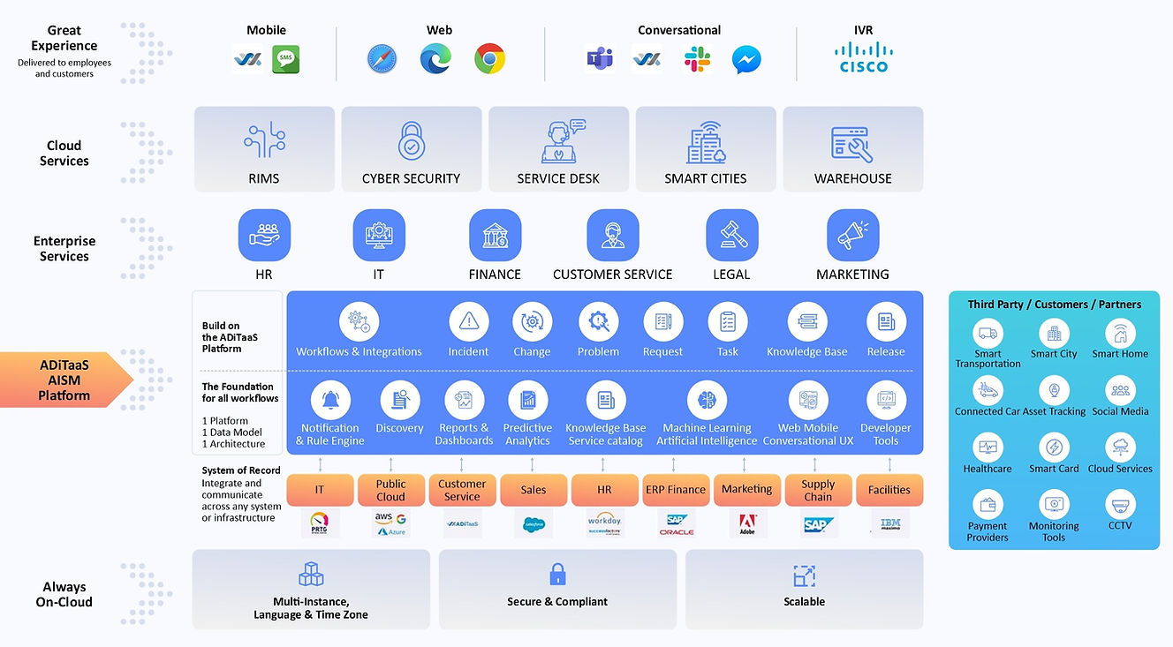

Thank you to Allied Digital!

Slide 8

Justin Grote
Datacenter Solutions Architect Allied Digital Services LLC
4x Microsoft MVP
PowerShell VSCode, Pester VSCode, PowerHTML, ModuleFast, SecretManagement, PoshNMAP, IPNetwork, Press, etc.
Session Content

Slide 9



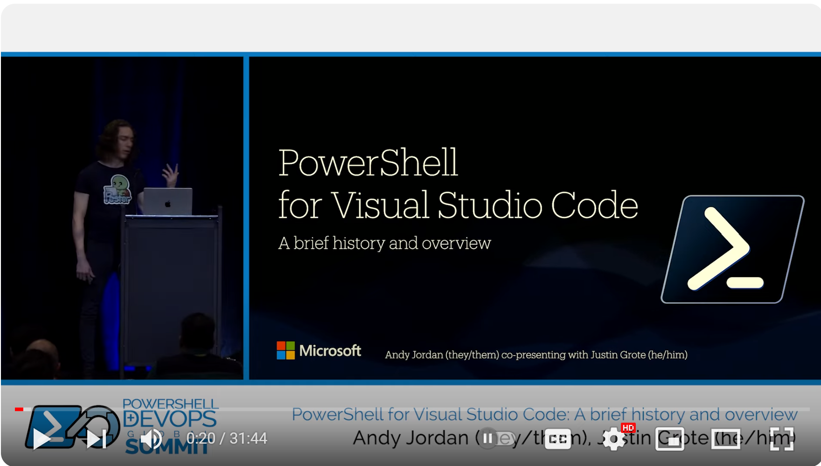
Previously

Slide 10
The Gist of the Past
Install the PowerShell Extension Pack
Check out the PowerShell-specific VSCode settings
Use git, GitHub, and GitHub PR + Github Actions extensions

Slide 11
Session Content

Slide 12
References
Visual Studio Code Updates Log
PowerShell for VSCode CHANGELOG
VSCode Youtube Channel (and shorts!)
Code 2020

Slide 13
Q&A
15 minutes
Session Content

